Slide 1

Learning Objectives
LO1 Distinguish among service, retail merchandising, and wholesale merchandising businesses.
LO2 Identify differences between a sole proprietorship and a corporation.
LO3 Explain the relationship between a subsidiary ledger and a controlling account.
© 2014 Cengage Learning. All Rights Reserved.

Slide 2
Merchandising Businesses
Lesson 9-1
LO1
Goods that a business purchases to sell are called merchandise.
A business that purchases and resells goods is called a merchandising business.
A merchandising business that sells to those who use or consume the goods is called a retail merchandising business.
A wholesale merchandising business buys and resells merchandise primarily to other merchandising businesses.

Slide 3
Forming a Corporation
Lesson 9-1
LO2
A corporation is an organization with the legal rights of a person which many persons or other corporations may own.
The assets or other financial resources available to a business are called capital.
Continued on next slide.

Slide 4
Forming a Corporation
Lesson 9-1
Continued from previous slide.
LO2
Each unit of ownership in a corporation is called a share of stock.
The owner of one or more shares of stock is called a stockholder.
The total shares of ownership in a corporation are called capital stock.
Continued on next slide.

Slide 5
Forming a Corporation
Lesson 9-1
Continued from previous slide.
LO2
The articles of incorporation, a legal document that identifies basic characteristics of a corporation, is a part of the application submitted to a state to become a corporation.
A state approves the formation of a corporation by issuing a charter, the legal right for a business to conduct operations as a corporation.

Slide 6
Subsidiary Ledgers and Controlling Accounts
Lesson 9-1
LO3
A business from which merchandise, supplies, or other assets are purchased is called a vendor.
A ledger that is summarized in a single general ledger account is called a subsidiary ledger.
Accountants often refer to a subsidiary ledger as a subledger.
The subsidiary ledger containing vendor accounts is called an accounts payable ledger.
An account in a general ledger that summarizes all accounts in a subsidiary ledger is called a controlling account.

Slide 7
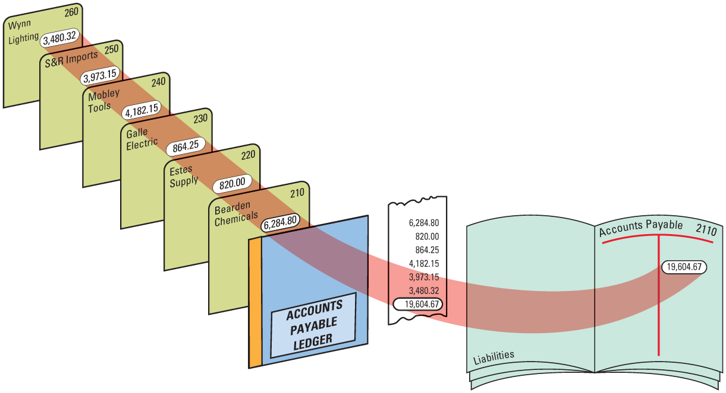
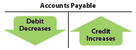
Subsidiary Ledgers and Controlling Accounts
Lesson 9-1
LO3

Slide 8
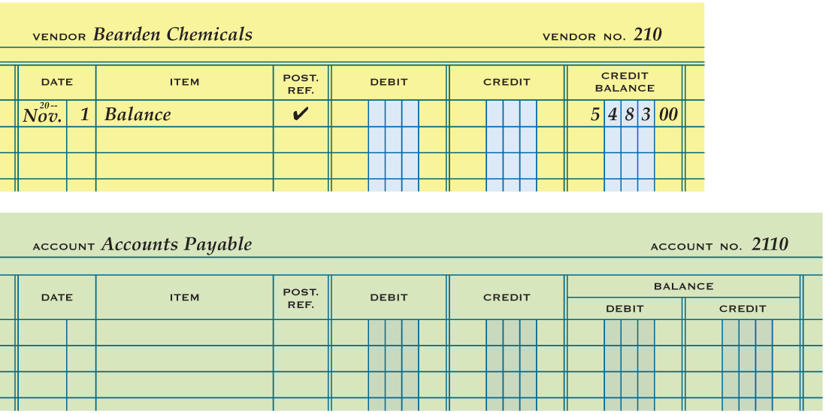
Subsidiary Ledger Form
Lesson 9-1
LO3
1
Account Name
2
Account Number
Date
3
4
Balance
5
Check Mark
6
Account Balance
Same column headings

Slide 9

Lesson 9-1 Audit Your Understanding
Lesson 9-1
1. What is the primary difference between retail and wholesale merchandising businesses?
ANSWER
A retail merchandising business sells to those who use or consume the goods. A wholesale merchandising business buys and resells merchandise primarily to other merchandising businesses.

Slide 10
Lesson 9-1 Audit Your Understanding
Lesson 9-1
2. What allows a corporation to own property, incur liabilities, and enter into contracts in its own name?
ANSWER
A corporation, through the rights granted in its charter, has the legal rights of a person.

Slide 11
Lesson 9-1 Audit Your Understanding
Lesson 9-1
3. What is the principal difference between the accounting records of proprietorships and corporations?
ANSWER
Proprietorships have a single capital and drawing account for the owner. A corporation has separate capital accounts for the stock issued and for the earnings kept in the business.

Slide 12
Lesson 9-1 Audit Your Understanding
Lesson 9-1
4. What is the relationship between a controlling account and a subsidiary ledger?
ANSWER
The sum of the subsidiary ledger accounts is equal to the balance in the general ledger controlling account.

Slide 13
Lesson 9-1 Audit Your Understanding
Lesson 9-1
5. What column on a general ledger form is not on an accounts payable ledger form?
ANSWER
Debit Balance

Slide 14
Work Together 9-1 On You Own 9-1
Work Together
9-1 (Excel)
Modeled
On Your Own
9-1 (Excel)
Complete

Slide 15

Learning Objectives
LO4 Describe accounting procedures used in ordering merchandise.
LO5 Discuss the purpose of a special journal.
LO6 Journalize purchases of merchandise on account using a purchases journal.
© 2014 Cengage Learning. All Rights Reserved.

Slide 16
Measuring Inventory
Lesson 9-2
LO4
A list of assets, usually containing the value of individual items, is called an inventory.
The goods a business has on hand for sale to customers is called merchandise inventory.

Slide 17
Perpetual Inventory Method
Lesson 9-2
LO4
An inventory determined by keeping a continuous record of increases, decreases, and the balance on hand of each item of merchandise is called a perpetual inventory.

Slide 18
Periodic Inventory Method
Lesson 9-2
LO4
A merchandise inventory evaluated at the end of a fiscal period is called a periodic inventory.
When a periodic inventory is conducted by counting, weighing, or measuring items of merchandise on hand, it is called a physical inventory.

Slide 19
Cost of Goods Sold
Lesson 9-2
LO4
The amount a business pays for goods it purchases to sell is called cost of merchandise.

Slide 20
Ordering Merchandise
Lesson 9-2
LO4
A form requesting the purchase of merchandise is called a requisition.
A form requesting that a vendor sell merchandise to a business is called a purchase order.

Slide 21
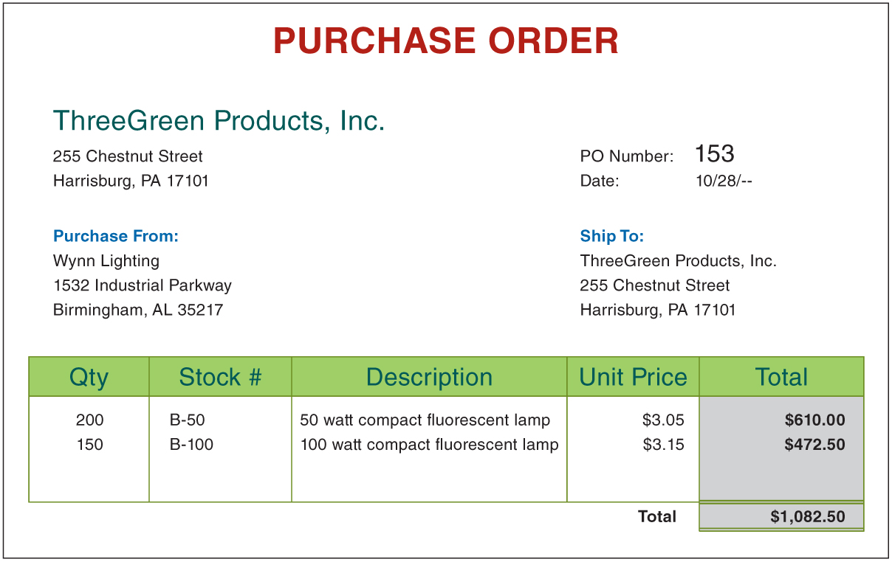
Ordering Merchandise
Lesson 9-2
LO4

Slide 22
Using Special Journals
Lesson 9-2
LO5
A journal used to record only one kind of transaction is called a special journal.
Businesses typically use five journals:
Purchases journal—for all purchases of merchandise on account
Cash payments journal—for all cash payments
Sales journal—for all sales of merchandise on account
Cash receipts journal—for all cash receipts
General journal—for all other transactions

Slide 23
Purchases Journal
Lesson 9-2
LO6
A transaction in which the items purchased are to be paid for later is called a purchase on account.
A purchases journal is a special journal used to record only purchases of merchandise on account.
A journal amount column headed with an account title is called a special amount column.

Slide 24
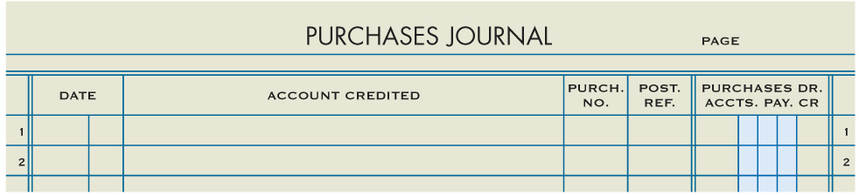
Purchases Journal
Lesson 9-2
LO6

Slide 25
Purchase Invoice
Lesson 9-2
LO6
An invoice used as a source document for recording a purchase on account transaction is called a purchase invoice.
An agreement between a buyer and a seller about payment for merchandise is called the terms of sale.
The date by which an invoice must be paid is called the due date.

Slide 26
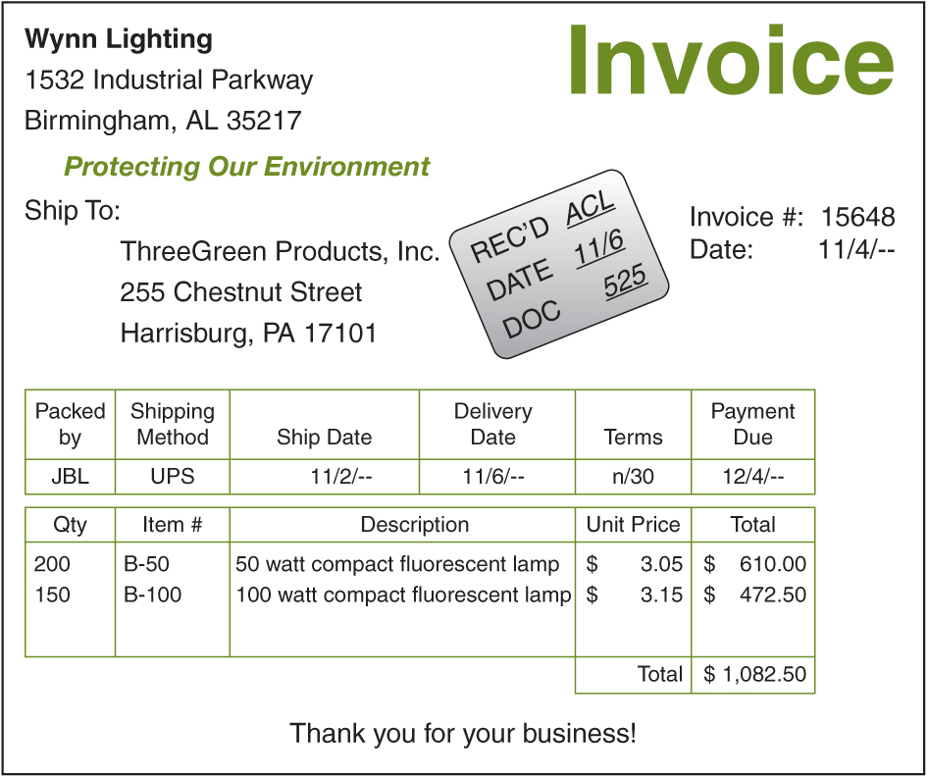
Purchase Invoice
Lesson 9-2
LO6
1. Record the initials of the employee processing the invoice, date received, and the purchase invoice number in the stamp.
1
2. Place a check mark by each of the amounts in the Total column to show that the items have been received and that amounts have been checked and are correct.
3
✓
✓
3. Review the vendor’s terms and the payment due date.
✓
2

Slide 27
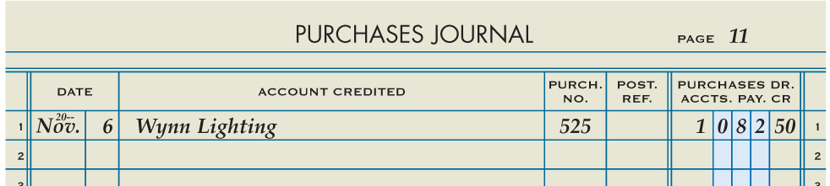
Purchasing Merchandise on Account
Lesson 9-2
LO6
Purchases
November 6. Purchased merchandise on account from Wynn Lighting, $1,082.50. Purchase Invoice No. 525.
1,082.50
Accounts Payable
1,082.50
1
Date
2
Vendor Name
3
Purchase Invoice Number
1. Write the date in the Date column.
Amount
4
2. Write the vendor account title in the Account Credited column.
3. Write the purchase invoice number in the Purch. No. column.
4. Write the amount of the invoice in the special amount column.

Slide 28
Lesson 9-2 Audit Your Understanding
Lesson 9-2
1. What is the difference between a periodic inventory system and a perpetual inventory system?
ANSWER
With a periodic inventory system, the value of the inventory is determined by a physical count. With a perpetual inventory system, the value of the inventory on hand is determined by a continuous record of increases and decreases.

Slide 29
Lesson 9-2 Audit Your Understanding
Lesson 9-2
2. When the perpetual inventory system is used, in what account are purchases recorded? In what account are purchases recorded when the periodic inventory system is used?
ANSWER
In a perpetual inventory system, purchases are recorded in the Merchandise Inventory account. In a periodic inventory system, purchases are recorded in the Purchases account.

Slide 30
Lesson 9-2 Audit Your Understanding
Lesson 9-2
3. Identify the four special journals typically used by a business.
ANSWER
Purchases journal, cash payments journal, sales journal, cash receipts journal

Slide 31
Lesson 9-2 Audit Your Understanding
Lesson 9-2
4. How are special amount columns used in a journal?
ANSWER
Special amount columns are used for frequently occurring transactions.

Slide 32
Lesson 9-2 Audit Your Understanding
Lesson 9-2
5. Why are there two account titles in the amount column of the purchases journal?
ANSWER
All transactions for purchasing merchandise on account involve a debit to Purchases and a credit to Accounts Payable.

Slide 33
Lesson 9-2 Audit Your Understanding
Lesson 9-2
6. What is the advantage of having special amount columns in a journal?
ANSWER
Using special amount columns eliminates writing general ledger account titles in the Account Title column, which saves time and helps to reduce mistakes.

Slide 34
Lesson 9-2 Audit Your Understanding
Lesson 9-2
7. What information is contained on a purchase invoice?
ANSWER
A purchase invoice lists the vendor name and address; the date; the quantity, description, and price of each item; and the total amount of the purchase.

Slide 35
Work Together 9-2 On You Own 9-2
Work Together
9-2 thru 9-5 work (Excel)
Modeled
Page 254
Use
9-2 Pur Jrnl (tab)
On Your Own
9-2 thru 9-5 own (Excel)
Complete
Page 254
Use
9-2 Pur Jrnl (tab)

Slide 36

Learning Objectives
LO7 Post merchandise purchases to an accounts payable ledger and a general ledger.
© 2014 Cengage Learning. All Rights Reserved.

Slide 37
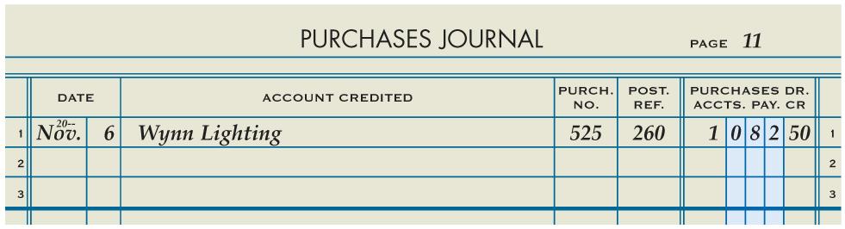
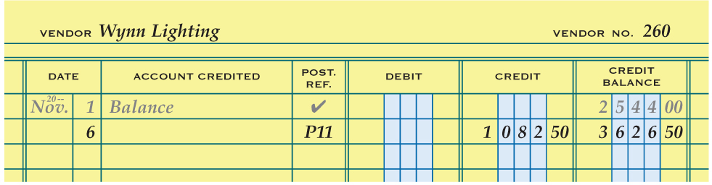
Posting from a Purchases Journal to an Accounts Payable Ledger
Lesson 9-3
LO7
1
2
3
5
4
1. Write the date in the Date column of the vendor account.
2. Write the journal page number in the Post. Ref. column of the account.
3. Write the credit amount in the Credit column of the vendor account.
4. Add the amount in the Credit column to the previous balance in the Credit Balance column and write the new account balance in the Credit Balance column.
5. Write the vendor number in the Post. Ref. column of the journal.

Slide 38
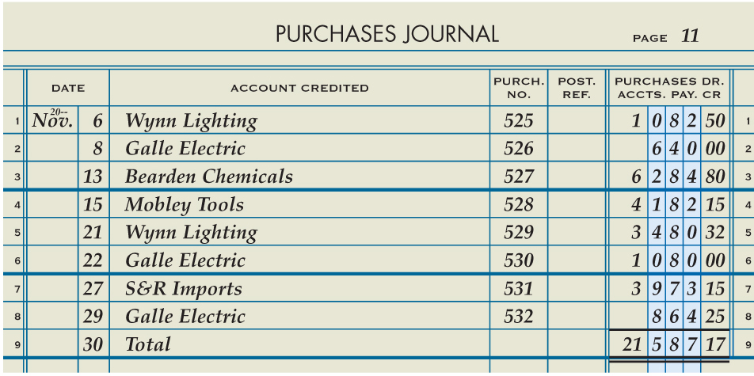
Totaling and Ruling a Purchases Journal
Lesson 9-3
LO7
5
Total Amount
2
Date
3
Total
Single Rule
4
Total Column
Double Rule
1
6

Slide 39
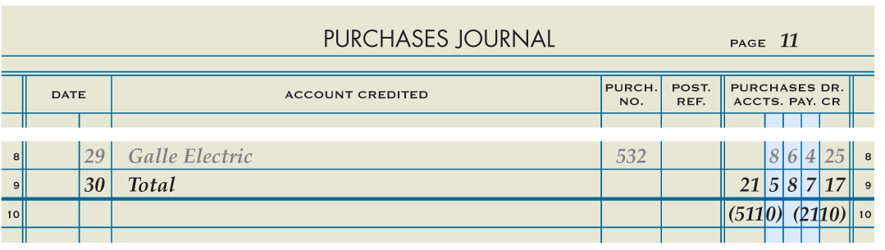
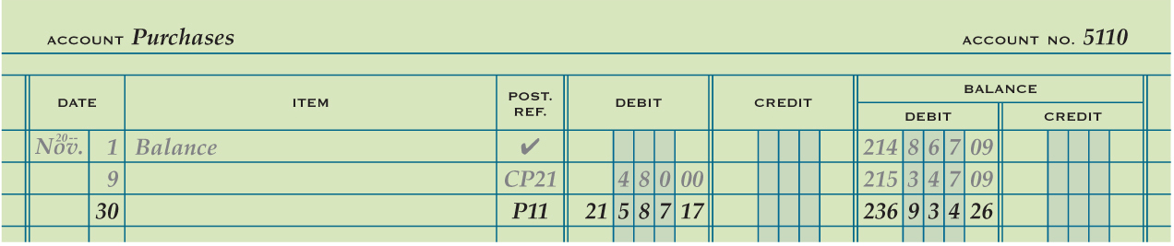
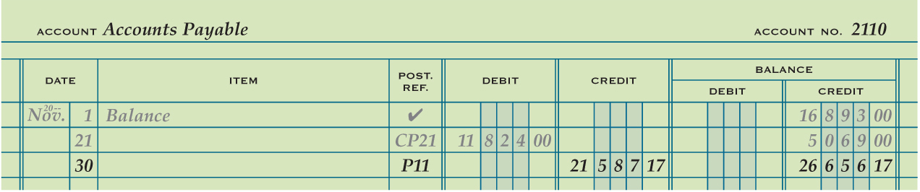
Posting the Total of a Purchases Journal to a General Ledger
Lesson 9-3
LO7
1
2
3
5
Account Number
4
5
Journal Number
Account Balance
1
Date
2
3
Debit or Credit
4

Slide 40
Lesson 9-3 Audit Your Understanding
Lesson 9-3
1. Why should a business frequently post from the purchases journal to the accounts payable ledger?
ANSWER
Posting frequently to the accounts payable ledger helps ensure that vendor accounts are paid on time and that the business can continue purchasing goods and services on account.

Slide 41
Lesson 9-3 Audit Your Understanding
Lesson 9-3
2. Why is it important to record a posting reference in the accounts payable ledger?
ANSWER
It provides an audit trail that allows an employee to trace the transaction back to the journal and page number.

Slide 42
Lesson 9-3 Audit Your Understanding
Lesson 9-3
3. Why is the vendor number written in the Post. Ref. column of the purchases journal?
ANSWER
To provide an audit trail to the account where the transaction was posted

Slide 43
Work Together 9-3 On You Own 9-3
Work Together
9-2 thru 9-5 work (Excel)
Modeled
Page 259
Use
9-2 Pur Jrnl (tab)
9-3 AP Sub Led (tab)
9-3 Gen Led (tab)
On Your Own
9-2 thru 9-5 own (Excel)
Complete
Page 259
Use
9-2 Pur Jrnl (tab)
9-3 AP Sub Led (tab)
9-3 Gen Led (tab)

Slide 44

Learning Objectives
LO8 Record cash payments using a cash payments journal.
LO9 Record replenishment of a petty cash fund.
© 2014 Cengage Learning. All Rights Reserved.

Slide 45
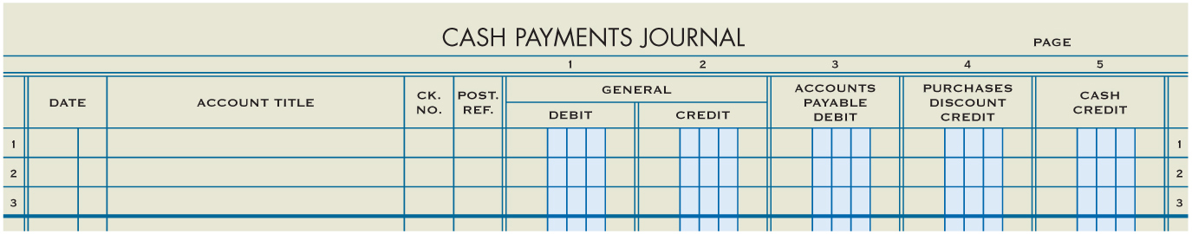
Cash Payments Journal
Lesson 9-4
LO8
A cash payments journal is a special journal used to record only cash payment transactions.

Slide 46
Trade Discount
Lesson 9-4
LO8
The retail price listed in a catalog or on an Internet site is called a list price.
A trade discount is a reduction in the list price granted to a merchandising business.
The price after the trade discount has been deducted from the list price is referred to as the net price.

Slide 47
Cash Discount
Lesson 9-4
LO8
A cash discount is a deduction that a vendor allows on an invoice amount to encourage prompt payment.
A journal amount column that is not headed with an account title is called a general amount column.

Slide 48
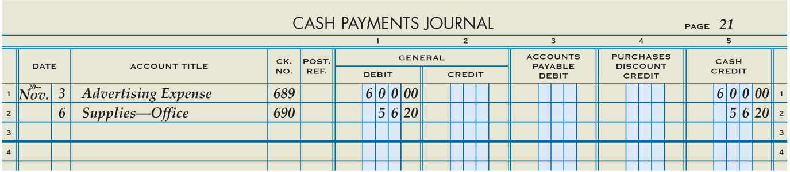
Cash Payment of an Expense
Lesson 9-4
LO8
Advertising Expense
November 3. Wrote a check to Kelser Promotions for advertising, $600.00. Check No. 689.
600.00
Cash
600.00
1
Date
2
Account Title
Check Number
4
Debit
Credit
3
5

Slide 49
Buying Supplies for Cash
Lesson 9-4
LO8
Supplies—Office
November 6. Wrote a check to Wells Office Supply for store supplies, $56.20. Check No. 690.
56.20
Cash
56.20
1
Date
2
Account Title
Check Number
4
Debit
Credit
3
5

Slide 50
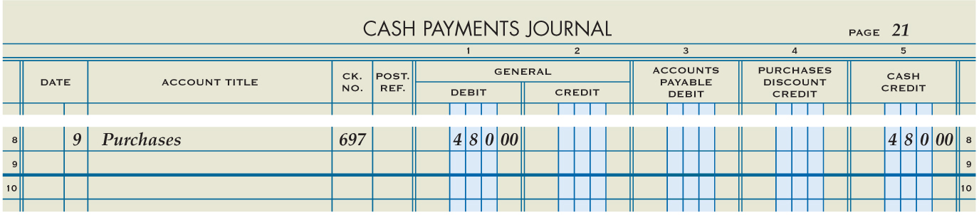
Cash Payments for Purchases
Lesson 9-4
LO8
Purchases
November 9. Purchased merchandise from Polar Refrigeration for cash, $480.00. Check No. 697.
480.00
Cash
480.00
1
Date
2
Account Title
Check Number
4
Debit
Credit
3
5

Slide 51
Cash Payments on Account with Purchases Discounts
Lesson 9-4
LO8
The period of time during which a customer may take a cash discount is called the discount period.
When a company that has purchased merchandise on account takes a cash discount, it is called a purchases discount.
An account that reduces a related account on a financial statement is called a contra account.

Slide 52
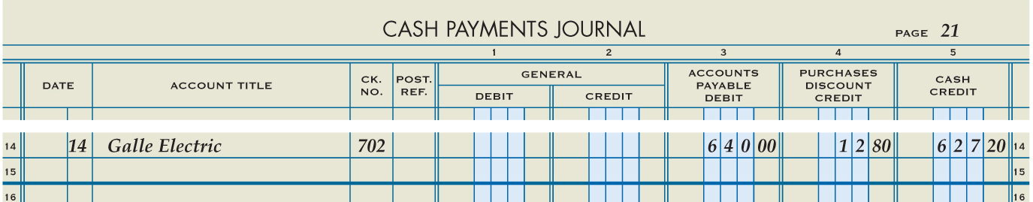
Cash Payments on Account with Purchases Discounts
Lesson 9-4
LO8
Accounts Payable
November 14. Paid cash on account to Galle Electric, $627.20, covering Purchase Invoice No. 489 for $640.00, less 2% discount, $12.80. Check No. 702.
640.00
Purchases Discount
12.80
Cash
Purchase Invoice Amount
627.20
1
Date
4
2
Vendor Name
Check Number
Cash Discount
3
5
Purchase Invoice Amount Less the Cash Discount
6

Slide 53
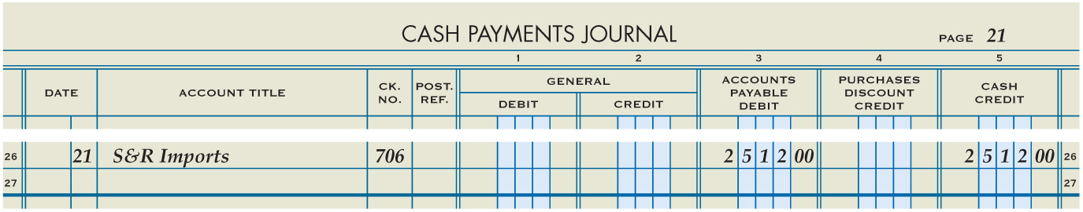
Cash Payments on Account without Purchases Discounts
Lesson 9-4
LO8
Accounts Payable
November 21. Wrote a check to S&R Imports to pay on account, $2,512.00, covering Purchase Invoice No. 468. Check No. 706.
2,512.00
Cash
2,512.00
2
Vendor Name
Total Purchase Invoice Account
1
Date
3
Check Number
4
Total Purchase Invoice Amount
5

Slide 54
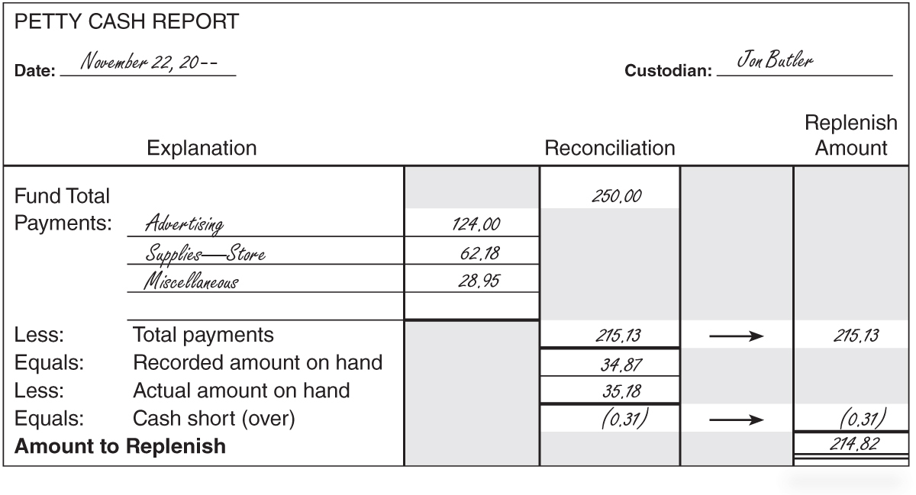
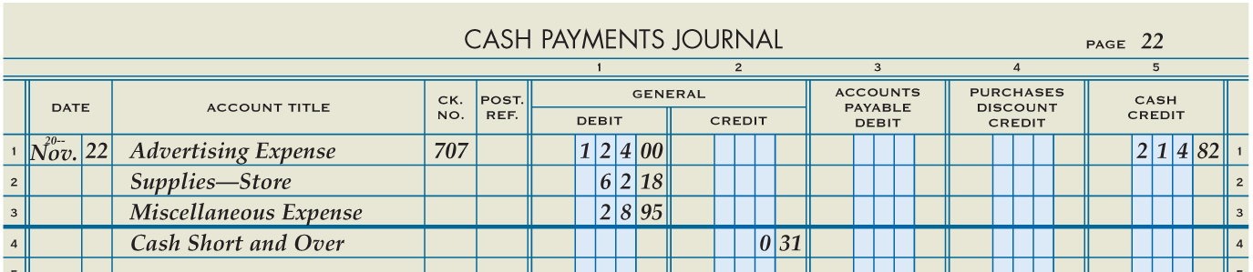
Replenishing a Petty Cash Fund
Lesson 9-4
LO9
November 22. Paid cash to replenish the petty cash fund, $214.82: advertising, $124.00; store supplies, $62.18; miscellaneous, $28.95; cash over, $0.31. Check No. 707.
Account Title
Check Number
Cash Over is a Credit
Date
Amounts
Total Cash Payment

Slide 55
Lesson 9-4 Audit Your Understanding
Lesson 9-4
1. What is the net price of an item with a $1,200.00 list price having a 60% trade discount?
ANSWER
$480.00

Slide 56
Lesson 9-4 Audit Your Understanding
Lesson 9-4
2. Why would a vendor offer a cash discount to a customer?
ANSWER
To encourage early payment

Slide 57
Lesson 9-4 Audit Your Understanding
Lesson 9-4
3. What is recorded in the general amount columns of the cash payments journal?
ANSWER
Cash payment transactions that do not occur often

Slide 58
Lesson 9-4 Audit Your Understanding
Lesson 9-4
4. What is meant by terms of sale 2/10, n/30?
ANSWER
Two ten means 2% of the invoice amount may be deducted if the invoice is paid within 10 days of the invoice date. Net thirty means that the total invoice amount must be paid within 30 days.

Slide 59
Lesson 9-4 Audit Your Understanding
Lesson 9-4
5. When journalizing a cash payment to replenish petty cash, what is entered in the Account Title column of the cash payments journal?
ANSWER
The titles of the accounts for which the petty cash funds were used

Slide 60
Lesson 9-4 Audit Your Understanding
Lesson 9-4
6. How is cash short recorded in the account, Cash Short and Over?
ANSWER
As a debit

Slide 61
Work Together 9-4 On You Own 9-4
Work Together
9-2 thru 9-5 work (Excel)
Modeled
Page 266
Use
9-4 Pet Csh Rpt (tab)
9-4 Csh Pmt Jrnl (tab)
On Your Own
9-2 thru 9-5 own (Excel)
Complete
Page 266
Use
9-4 Pet Csh Rpt (tab)
9-4 Csh Pmt Jrnl (tab)

Slide 62

Learning Objectives
LO10 Post cash payments to an accounts payable ledger and a general ledger.
© 2014 Cengage Learning. All Rights Reserved.

Slide 63
Posting from a Cash Payments Journal to an Accounts Payable Ledger
Lesson 9-5
LO10
A credit limit is the maximum outstanding balance allowed to a customer by a vendor.

Slide 64
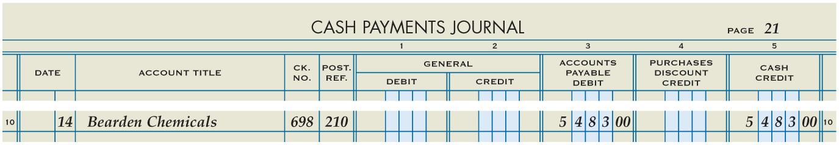
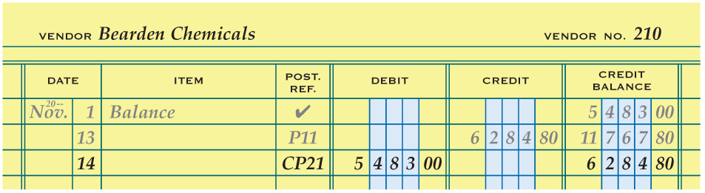
Posting from a Cash Payments Journal to an Accounts Payable Ledger
Lesson 9-5
LO10
Journal Page Number
2
3
Debit
Date
1
5
Vendor Number
4
Account Balance

Slide 65
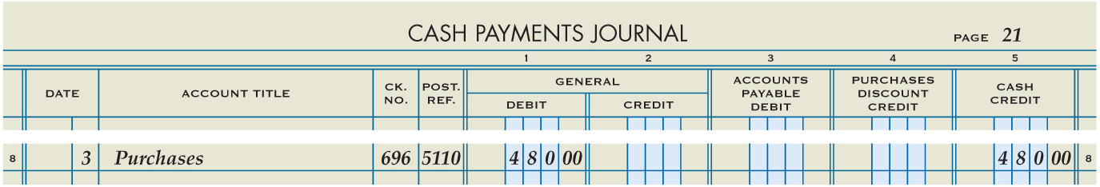
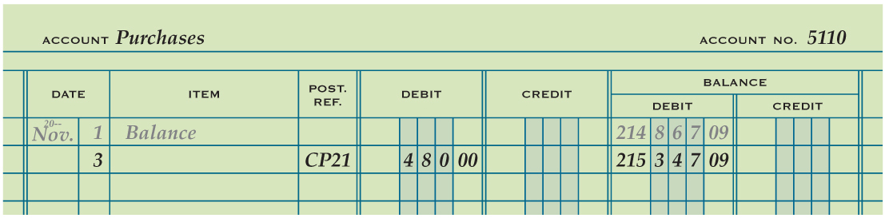
Posting from the General Amount Columns of a Cash Payments Journal to a General Ledger
Lesson 9-5
LO10
Journal Page Number
2
Date
1
3
Debit
5
Vendor Number
4
Account Balance

Slide 66
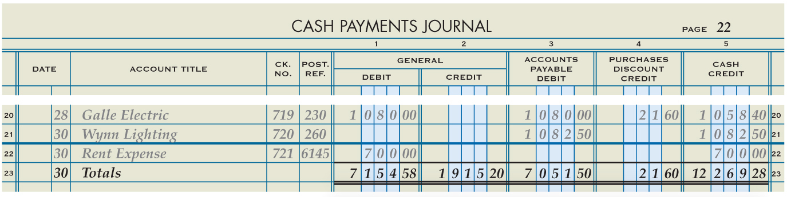
Totaling, Proving, and Ruling a Cash Payments Journal
Lesson 9-5
LO10
Number should not be there
1
Date
3
Single Rule
5
Double Rule
2
“Totals”
4
Column Total

Slide 67
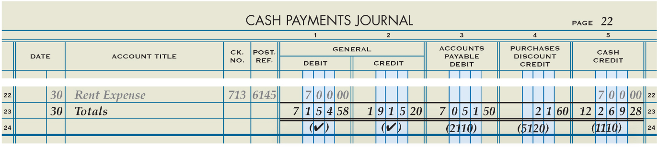
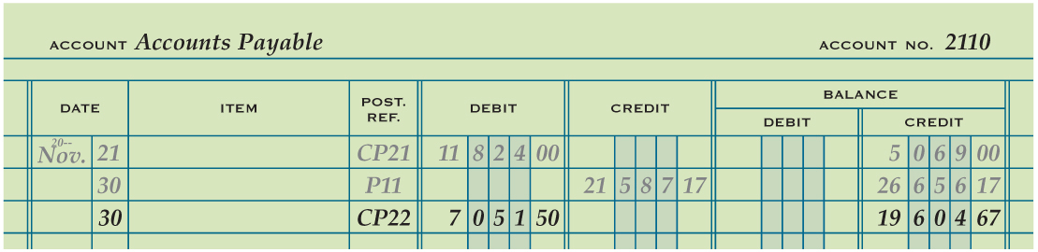
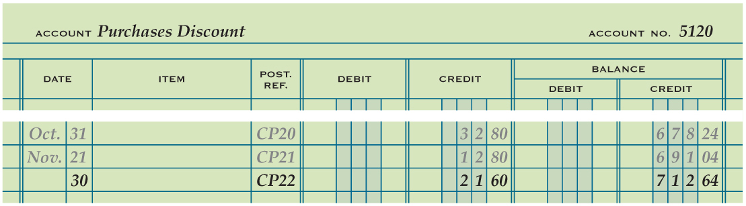
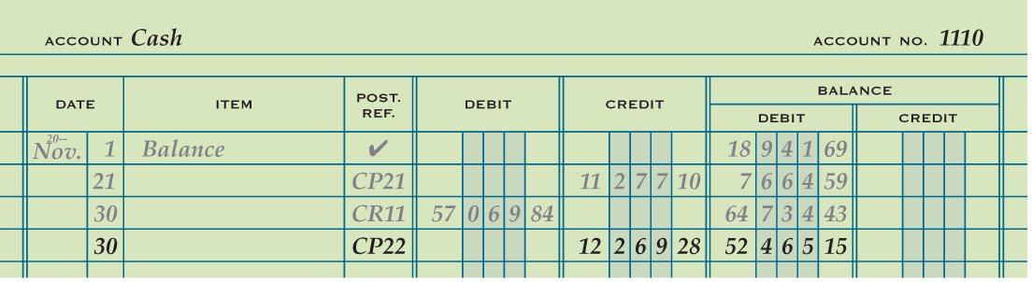
Posting from the Special Amount Columns of a Cash Payments Journal to a General Ledger
Lesson 9-5
LO10
Journal Page Number
2
Date
1
Debit or Credit Amount
Account Number
3
5
4
Account Balance
5
5
1
2
3
4
1
2
3
4

Slide 68
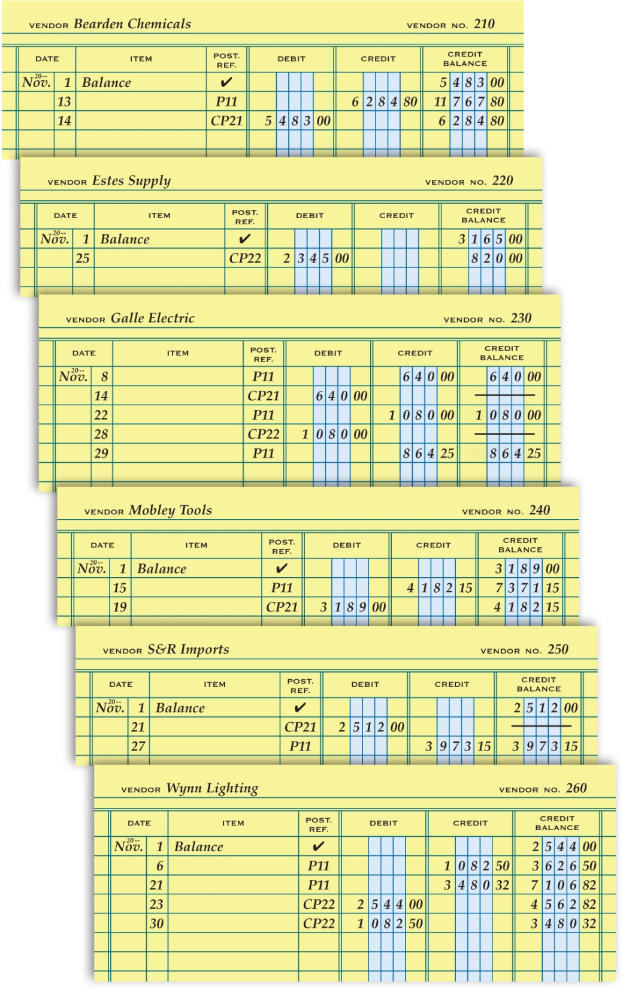
Completed Accounts Payable Ledger
Lesson 9-5
LO10

Slide 69
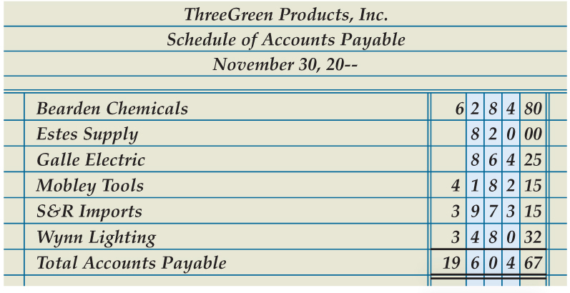
Proving the Accounts Payable Ledger
Lesson 9-5
LO10
A listing of vendor accounts, account balances, and the total amount due to all vendors is called a schedule of accounts payable.

Slide 70
Lesson 9-5 Audit Your Understanding
Lesson 9-5
1. In which column of the cash payments journal are the amounts that are posted individually to the accounts payable ledger?
ANSWER
Accounts Payable Debit

Slide 71
Lesson 9-5 Audit Your Understanding
Lesson 9-5
2. List the five steps for ruling a cash payments journal at the end of the month.
ANSWER
1. Rule a single line across all amount columns.
2. Write the date in the Date column.
3. Write Totals in the Account Title column.
4. Write each column total below the single line.
5. Rule a double line across all amount columns.

Slide 72
Lesson 9-5 Audit Your Understanding
Lesson 9-5
3. What is the relationship between a controlling account and a subsidiary ledger?
ANSWER
A controlling account balance in a general ledger must equal the sum of all account balances in a subsidiary ledger.

Slide 73
Work Together 9-5 On You Own 9-5
Work Together
9-2 thru 9-5 work (Excel)
Modeled
Page 273
Use
9-4 Csh Pmt Jrnl (tab)
9-3 AP Sub Led (tab)
9-3 Gen Led (tab)
9-5 Sched of AP (tab)
On Your Own
9-2 thru 9-5 own (Excel)
Complete
Page 273
Use
9-4 Csh Pmt Jrnl (tab)
9-3 AP Sub Led (tab)
9-3 Gen Led (tab)
9-5 Sched of AP (tab)

Slide 74
Application Problems
9-1 Application Problem
Excel
9-2 thru 9-5 Application Problem
Excel

Slide 75
Application Problems
9 Mastery Problem
Peachtree
9 Challenge Problem
Peachtree

Slide 76
Unit 9 Assessment
Unit 9 Review (ExamView)
90 % or Greater
5 Point Bonus on Unit 1 Concept Quiz (20% Bonus)
Unit 9 Part 1 Quiz (ExamView)
Concepts – 25 Questions (25 Points)
Unit 9 Part 2 Quiz (Excel)
Skills (30 Points)

